Slide 1
Time Series Analysis of Earth Observation Data
Gilberto Câmara
National Institute for Space Research (INPE), Brazil

Slide 2








With many thanks to…
Merret Buurman
Karine Ferreira
Lúbia Vinhas
Ricardo Cartaxo
Victor Maus
Gilberto Ribeiro
Alber Sanchez
Dalton Valeriano

Slide 3

A working definition of big data
≈
n << all Statistics: we have a small part of the data
n == all Big brother: we have all the data (do we?)
n ≈≈ all Big data: we have data close to problem size

Slide 4
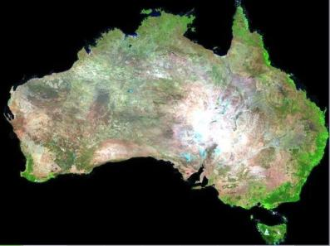


What changes with big EO data?
graphics: Geoscience Australia
What are we looking for in big EO data?

Slide 5
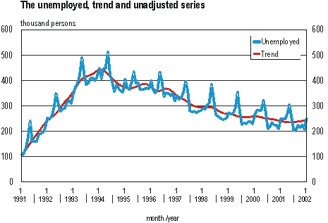
Time series of unemployment USA
source: Geoscience Australia

Slide 6
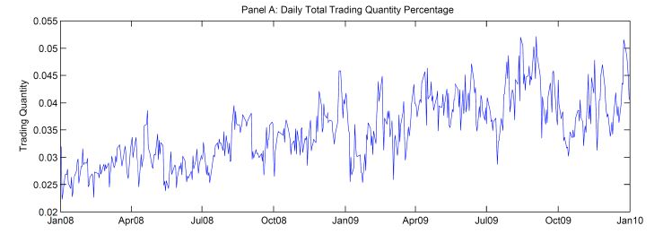
Time series of Wall Street

Slide 7
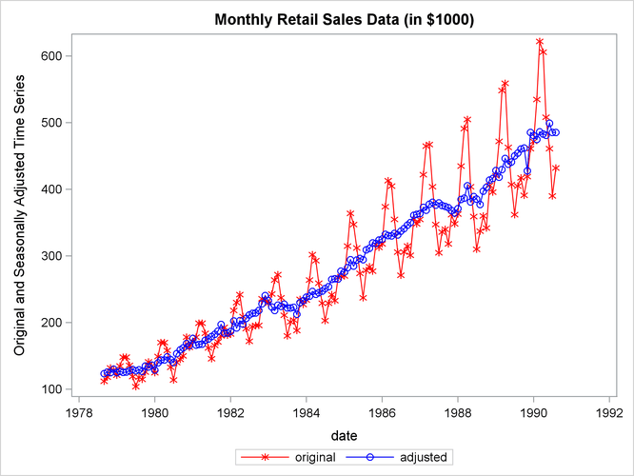
Time series of sales data

Slide 8
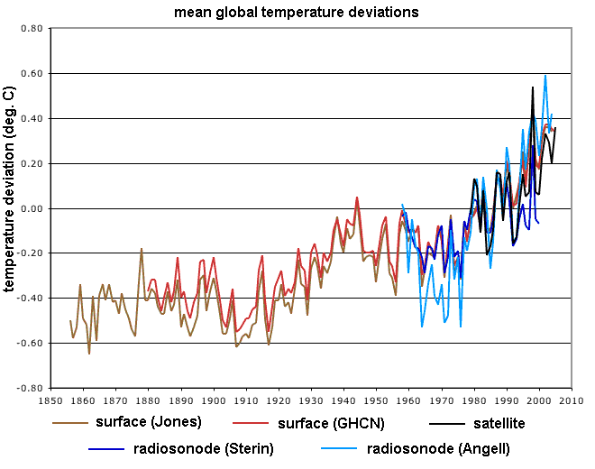
Time series of climate data

Slide 9
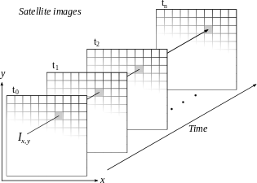
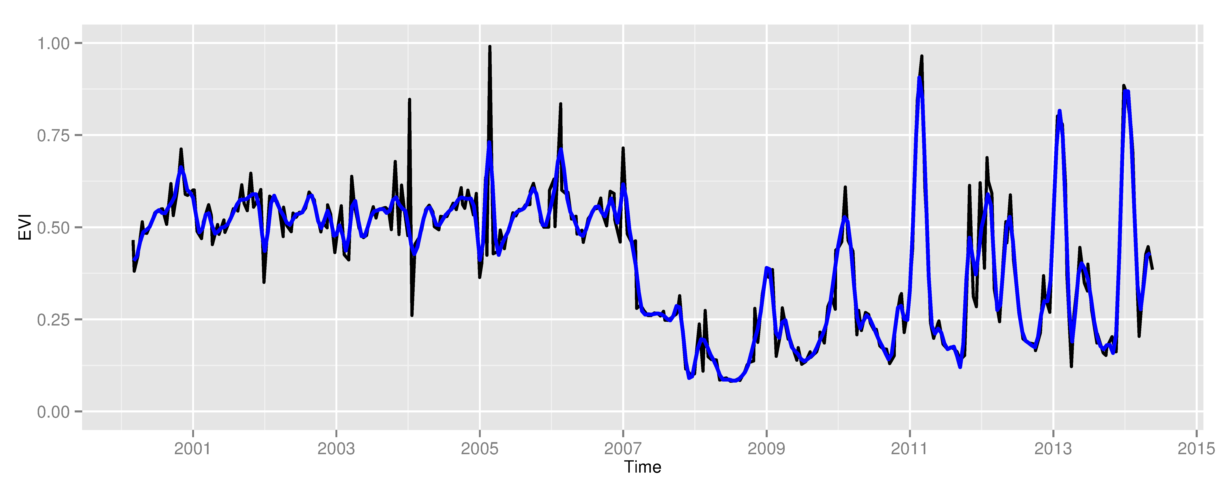
Space first, time later or time first, space later?
Space first: classify
images separately
Compare results in time
Time first: classify
time series separately
Join results to get maps

Slide 10
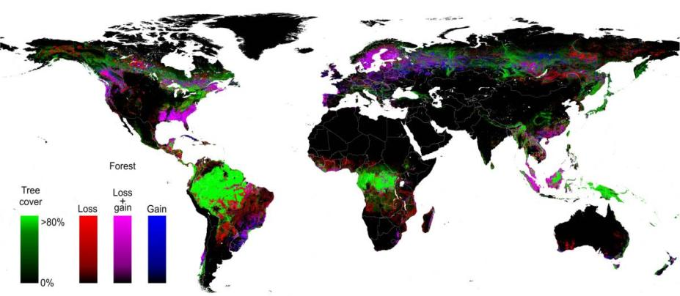
Space first, time later
Spatial data resolution is better than temporal resolution
Hansen et al. (2013)

Slide 11
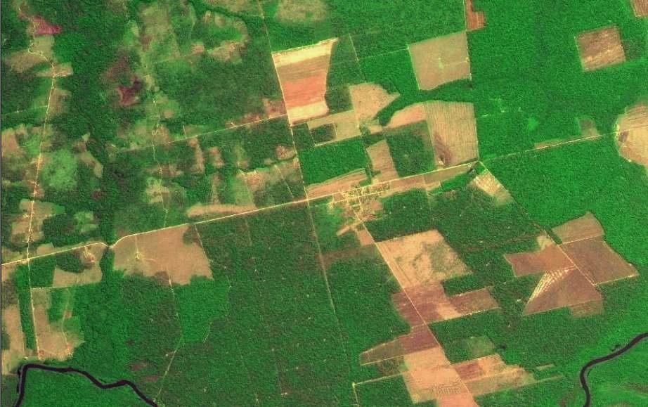
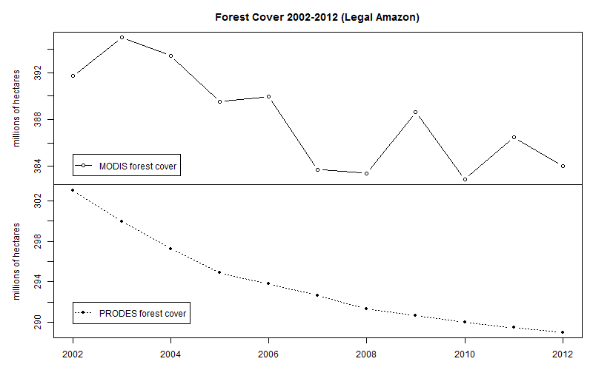
Space first can lead to inconsistent land trajectories
MODIS land cover: unrealistic forest gains and losses
Data sources: INPE, NASA. Analysis by M. Buurman

Slide 12
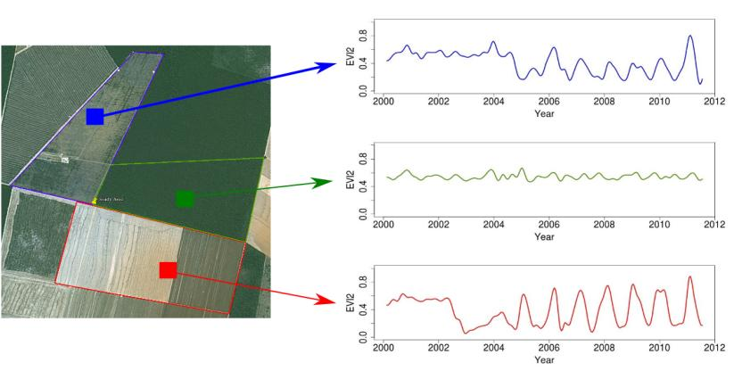
Time first, space later
Forest
Pasture
Agric
Área 1
Forest
Área 2
Forest
Agriculture
Área 3
“Remote sensing time series with adequate resolution provide data for describing landscape dynamics”
source: Victor Maus (INPE, IFGI)

Slide 13
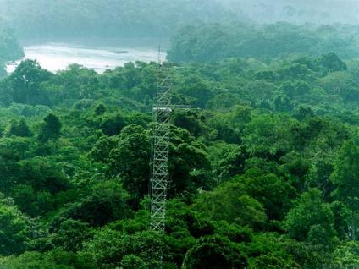
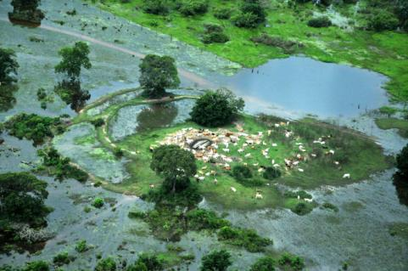
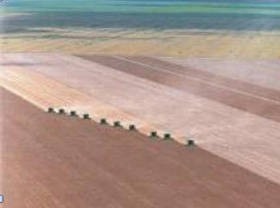
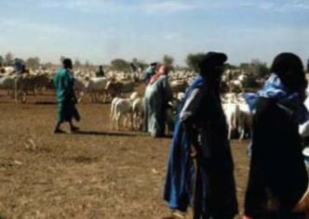
Land cover
tropical forest
wetlands
“the observed biophysical cover on the Earth’s surface"
Non-natural vegetation
shrublands

Slide 14
Land use
unmanaged forest
cattle production
“the arrangements, activities and inputs people undertake in a certain land cover type to produce, change or maintain it”
Temporary agriculture
shifting cultivation

Slide 15
Land trajectories
Forest
Pasture
Agric
Área 1
Forest
Área 2
Forest
Agriculture
Área 3
“The transformations of land cover due to actions of land use”
graphics: Victor Maus (INPE, IFGI)

Slide 16

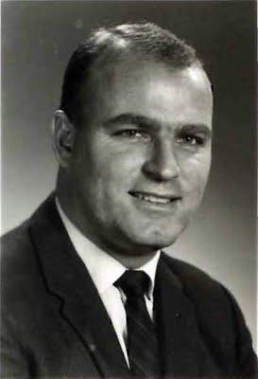

How does our brain represent time?
…by means of events: relevant moments of change
photos: Reginald Gooledge

Slide 17
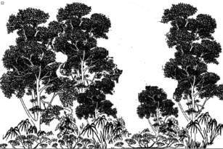
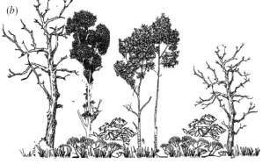
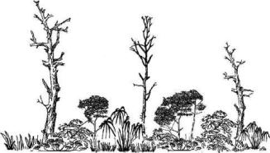
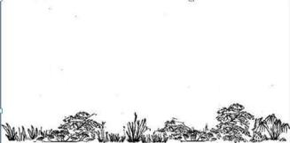
Land trajectories in forests
Exploração intensiva
80%
Event 1
Perda >50% do dossel
Event 2
50%
Perda >90% do dossel
Event 3
10%
Event 4
Corte raso
Floresta
0%
Floresta
Events of forest cover loss

Slide 18
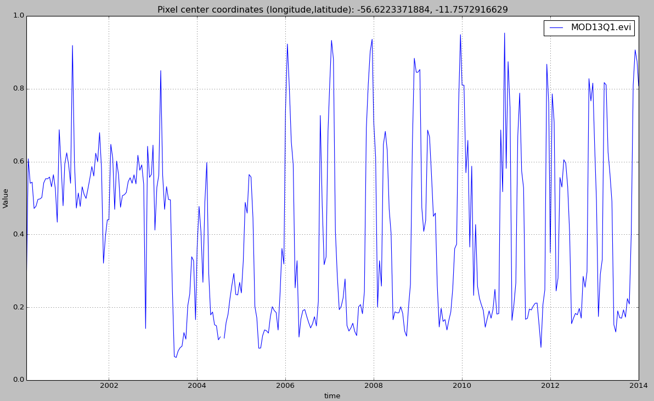

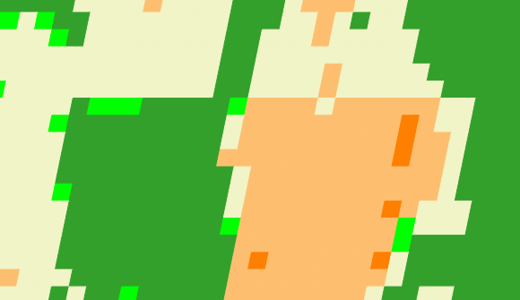
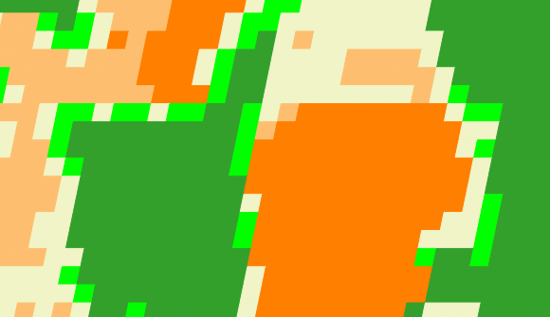
Land trajectories
Forest
Single cropping
Double cropping
2001
2006
2013

Slide 19
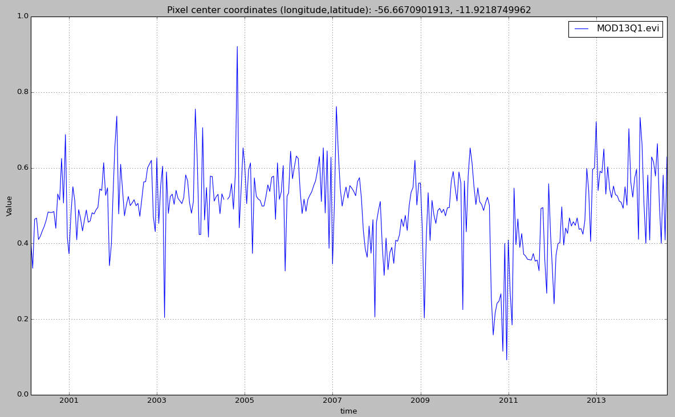
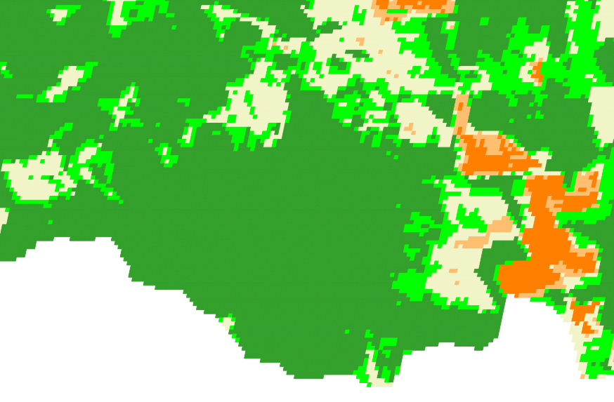
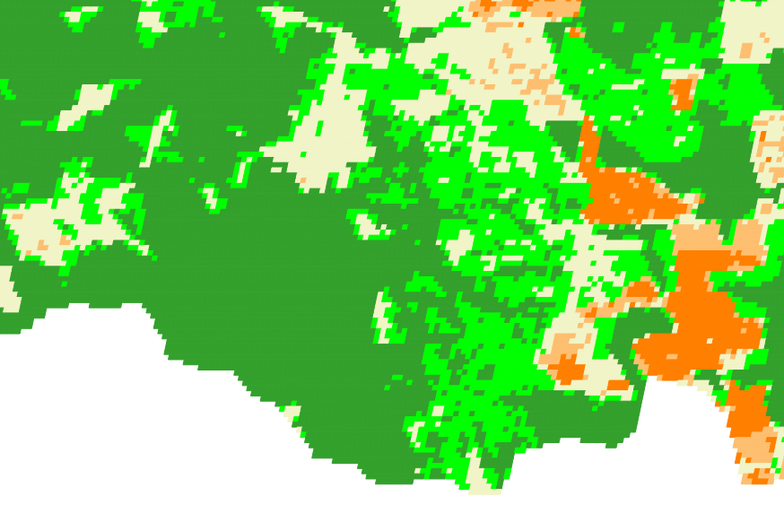
Land trajectories: forest degradation
EVI Time Series
2007
2009
2007
2009

Slide 20
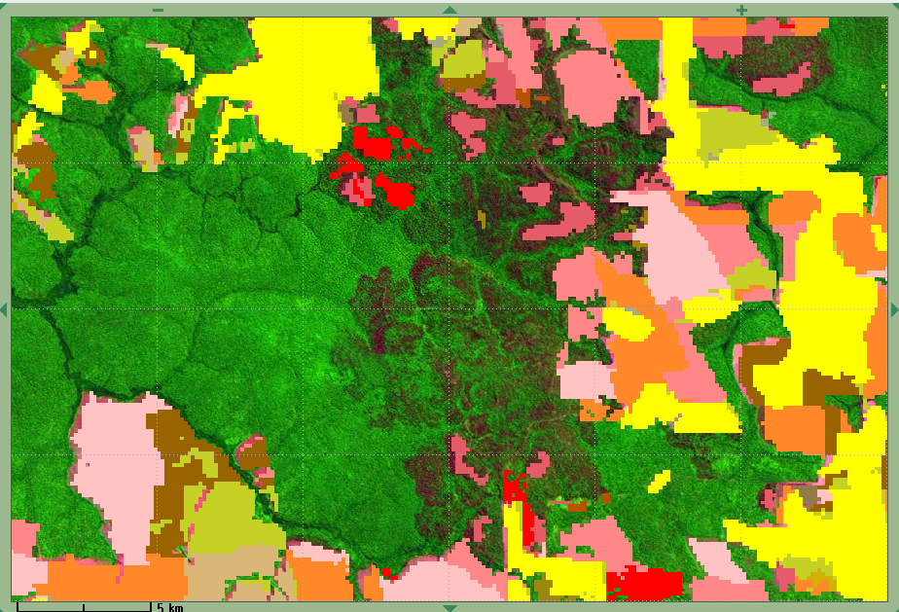
Land trajectories: forest degradation
EVI Time Series
2007
2009
PRODES
2007
2008

Slide 21
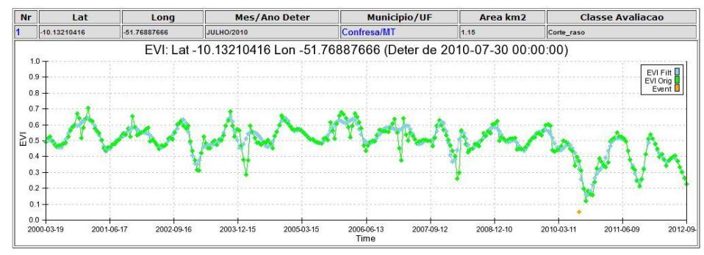
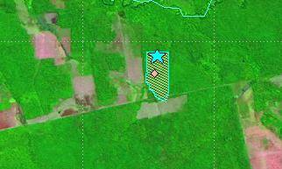
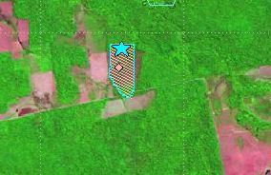
Land trajectories: deforestation events
images: INPE
2010
2011

Slide 22
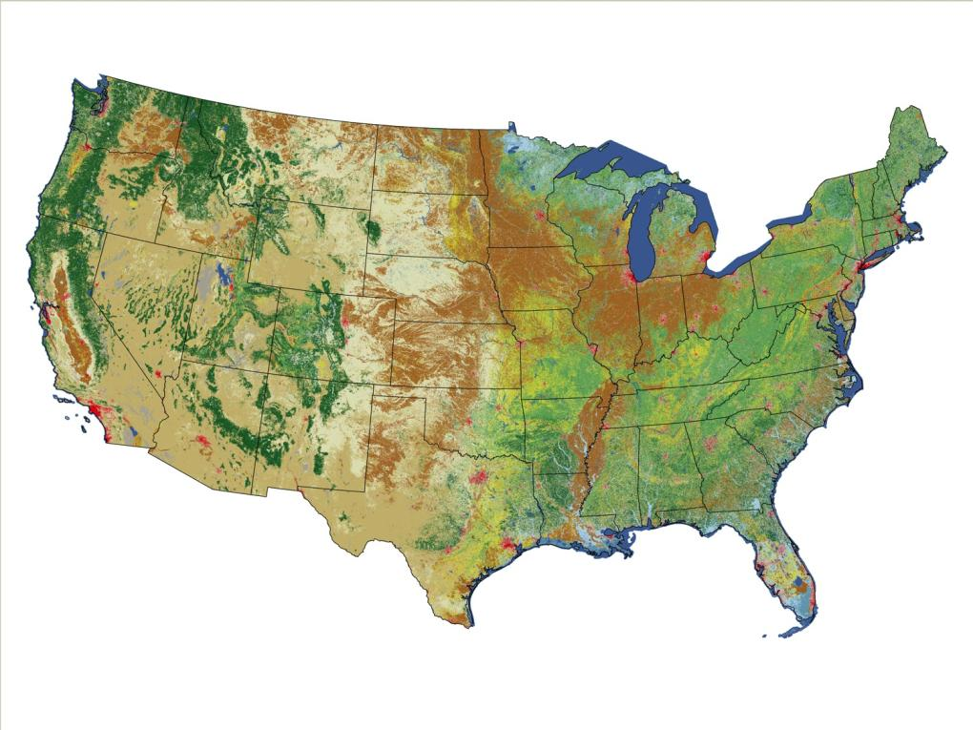
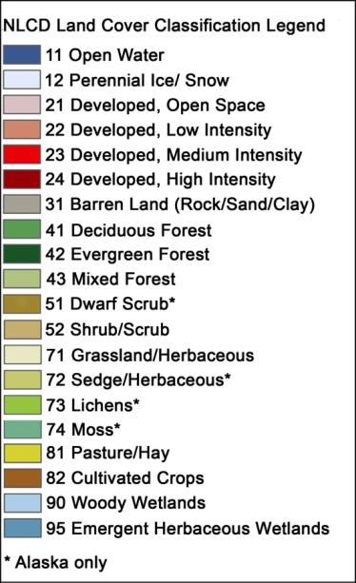
Is this what we want from big EO data?
US National Land Cover 2006
source: USGS

Slide 23
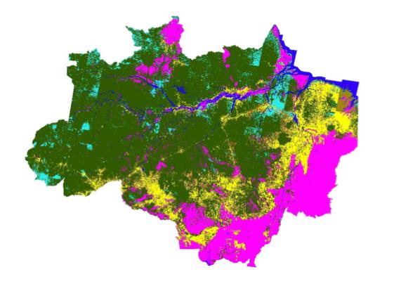
In search of a minimal land trajectory definition
graphics: INPE
The unbearable lightness of PRODES: complete transitions of forest to non-forest

Slide 24
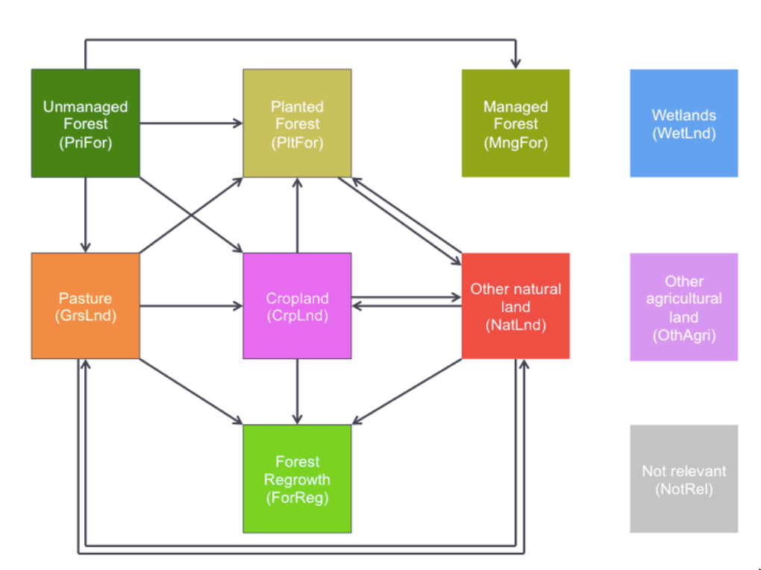
In search of a minimal land trajectory definition
source: IIASA
Transitions for land use modelling (GLOBIOM-Brazil)

Slide 25
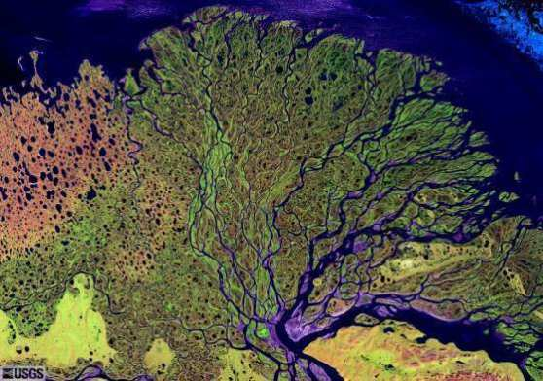

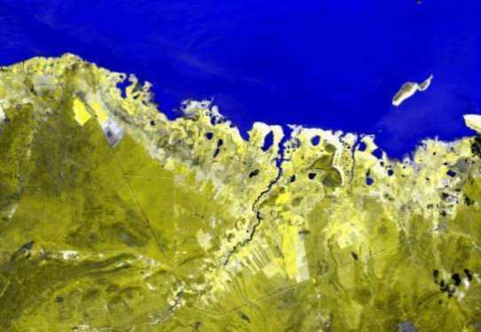
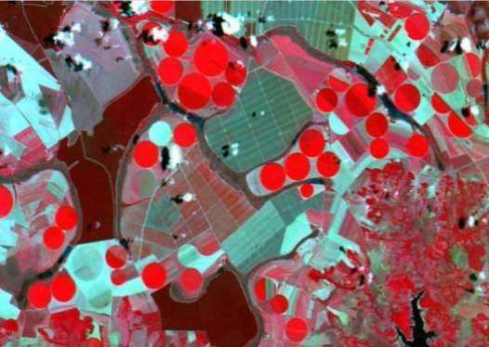
How do we find what we want in big EO data?
“In theory there is no difference between theory and practice. In practice there is.” (Yogi Berra)

Slide 26
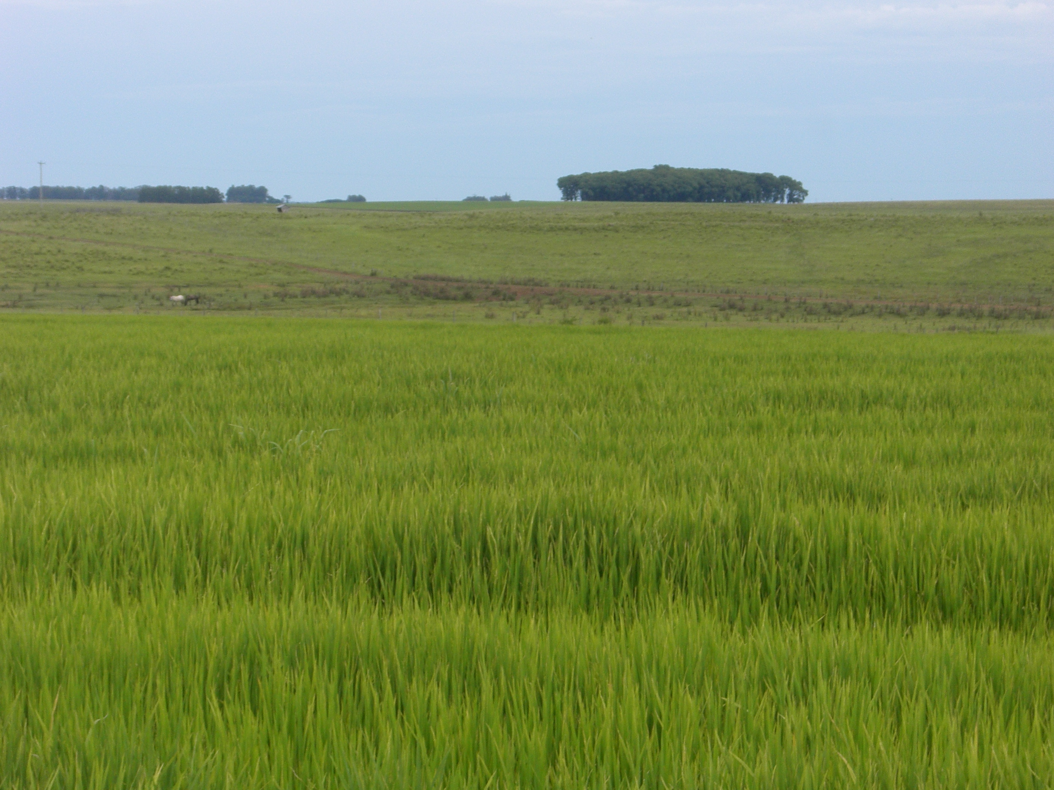
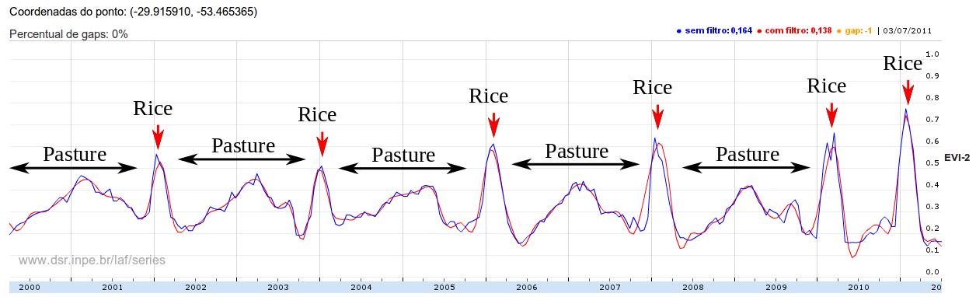
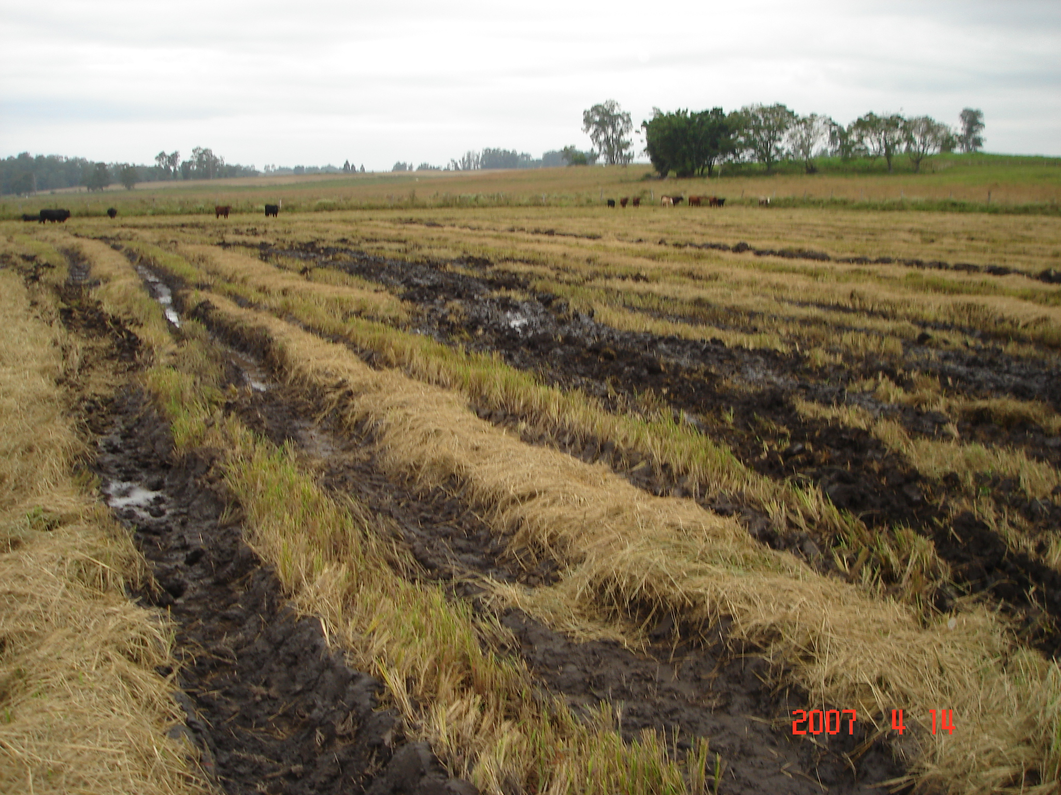
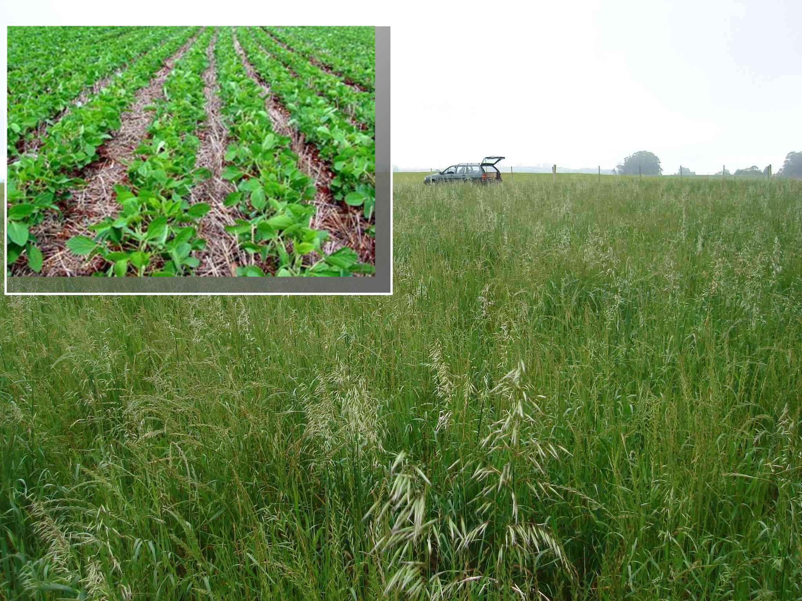
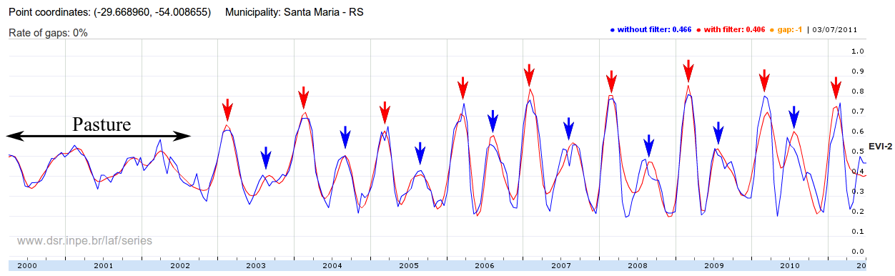
Assumption: shape recognition is key problem
Fallow
Fallow
Fallow
Fallow
Fallow
Soybean
Ryegrass
Victor Maus

Slide 27
Hypotesis: land patterns have distinct shapes
Forest
Pasture
Agric
Área 1
Forest
Área 2
Forest
Agriculture
Área 3
source: Victor Maus (INPE, IFGI)

Slide 28
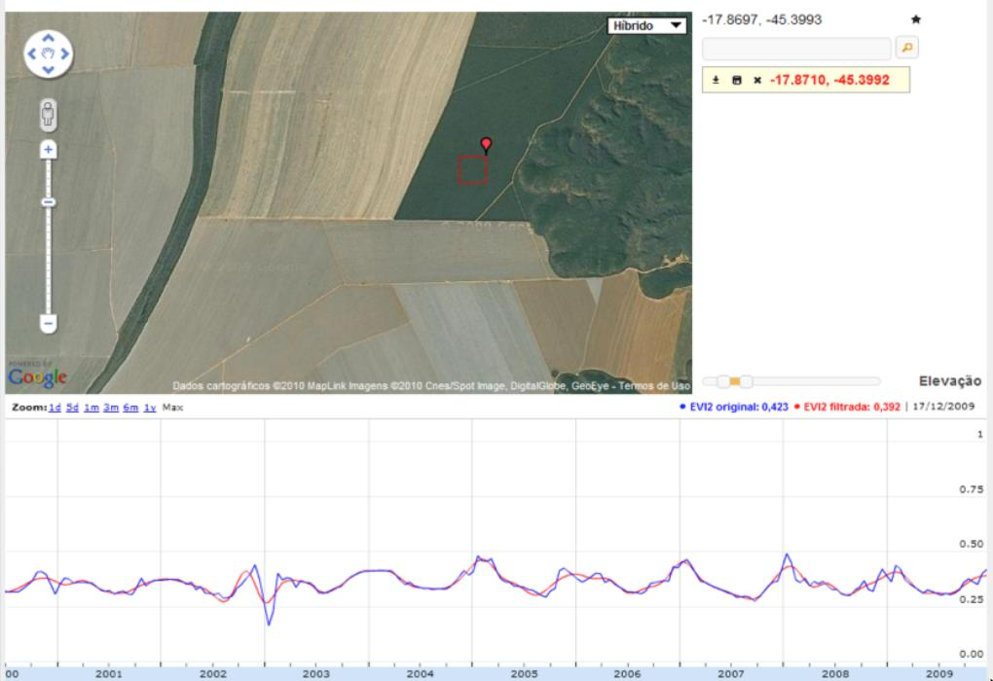
Tropical forest: stable signal + low seasonal change
One sample per year (PRODES)
graphics: LAF/INPE
source: INPE

Slide 29
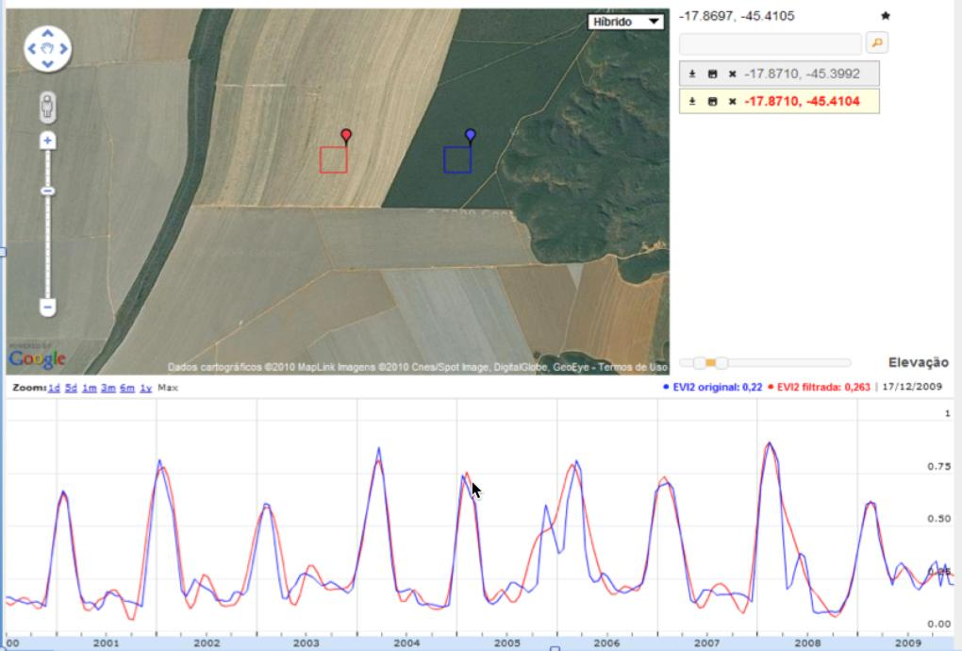
Single-crop grain production (60-120 days)
One sample per month (?)
graphics: LAF/INPE
source: INPE

Slide 30
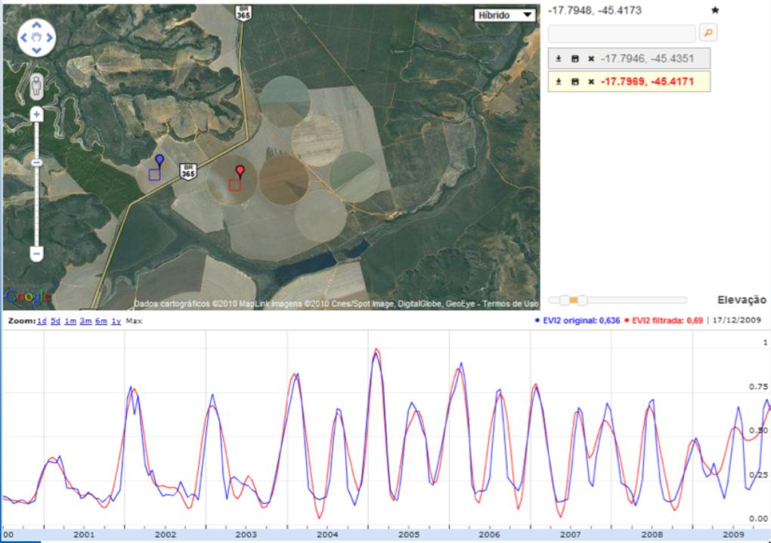
Double-cropping: soybeans + corn
Two samples per month (?)
graphics: LAF/INPE
source: INPE

Slide 31
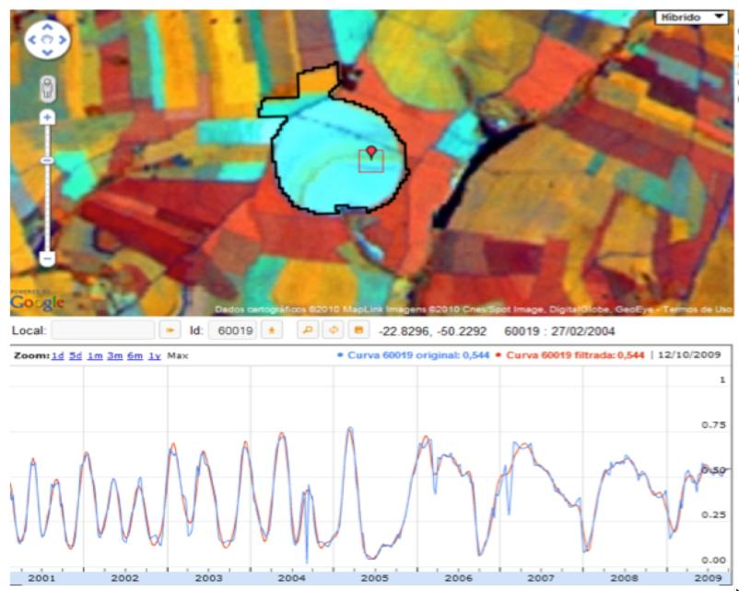
In practice: signals of varying frequencies
graphics: LAF/INPE

Slide 32
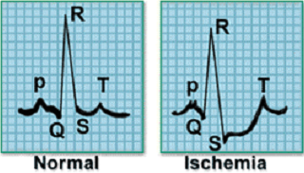
What do we want to do with time series?
Clustering
Classification
Pattern Matching
Novelty Detection
Keogh (2006)

Slide 33
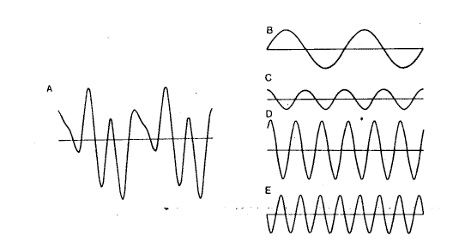
Fourier analysis of time series
A periodic time series (A) can be decomposed into sums and differences of sine and cosine functions of different frequencies (B-E)

Slide 34
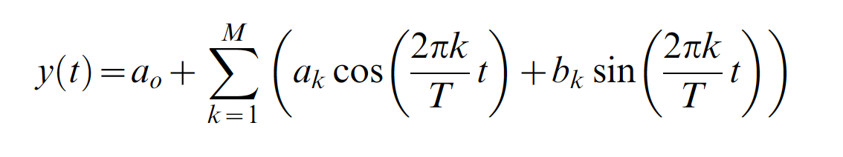
Classical harmonic series
Problem: truncation of the time series (how many terms?)
Phenology information may be present in 5th order harmonics
source: Hernance (2007)

Slide 35
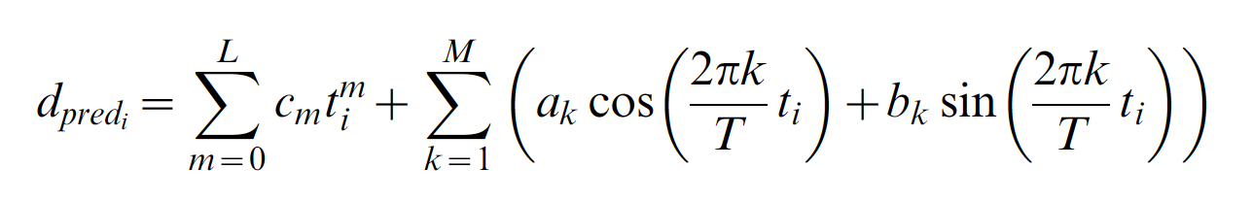

Non-classical harmonic series
Problem: parameter estimation
One approach: minimize roughness on dormant period
source: Hernance (2007)

Slide 36

Non-classical harmonic series
Hernance (2007)
Classical Fourier (A), Asymmetric weighting (B), Excessive roughness ©, balanced estimation (D)

Slide 37

Fitting an harmonic series to real data
Magnitude of variable star (600 nights)

Slide 38

Fitting an harmonic series
X_{t} = μ + α*cos(2*π*f₁*t) + β*sin(2*π*f₂*t)

Slide 39

Fitting an harmonic series to MODIS NDVI
source: De Beurs and Honebry (2010)

Slide 40


Sampling theorem: minimum rate to reconstruct a periodic signal
In theory: insufficient (above) and sufficient (below) sampling rates to reconstruct a periodic signal

Slide 41

Fitting a function to sample data
Willis Eschenbach
Hypothesis: periodic signal

Slide 42

Fitting a function to sample data
Willis Eschenbach
temp = (2 + sin(2 π* (julianday + lag)/365.25)) ˆ1.4

Slide 43

Time series analysis: parametric methods
TIMESAT: relate time series with crop phenology
Zhang et al. (2003), Jönsson and Eklundh (2004)

Slide 44

Time series analysis: parametric methods
Hermance et al.(2007)

Slide 45

Challenges with parametric approach
limited to agriculture
hard to cope with different crop varieties
source: INPE

Slide 46


Time series mining: prediction
Esling & Agon (2012), Zhu et al.(2012)
Predict the next LANDSAT image
predicted vs. observed forest pixels (pine forest)

Slide 47

Time series mining: event detection
Deviation from standard behaviour:
find subsequences that do not follow the model
Esling & Agon (2012)

Slide 48

Time series mining: event detection
BFAST: changes in a pine plantation (trend breaks)
Verbesselt et al. (2010)

Slide 49

Time series mining: pattern matching
Finding subsequences in a time series
High computational complexity
Patterns are idealized, data is noisy
Esling & Agon (2012)

Slide 50
Hypotesis: land patterns have distinct shapes
Forest
Pasture
Agric
Área 1
Forest
Área 2
Forest
Agriculture
Área 3
source: Victor Maus (INPE, IFGI)

Slide 51



Assumption: shape recognition is key problem
Fallow
Fallow
Fallow
Fallow
Fallow
Soybean
Ryegrass
Victor Maus

Slide 52
Land use patterns derive from phenological cycles
Temporal patterns of EVI modis 16 days
Arvor et al. (2011)

Slide 53

Temporal patterns of different classes
Maus (2016)

Slide 54
How to match land use patterns in a remote sensing time series?
A good match needs shape similarity and temporal coherence

Slide 55

What is similarity?
resemblance, likeness, sameness, comparability, correspondence, analogy, parallel, equivalence;
adapted from Keogh (2006)

Slide 56


Dynamic Time Warping: pattern matching by similarity
Arvor et al (2012), Keogh (2006)
DTW “warps” the time axis: nonlinear matching

Slide 57


Dynamic Time Warping (DTW)
Euclidean
DTW
Jan
Feb
Sep
May
Sep
May
Similarity between patterns even with different phase
… and/or patterns with different lengths

Slide 58
Dynamic Time Warping: pattern matching
Arvor et al (2012), Eamon Keogh
DTW “warps” the time axis: nonlinear matching

Slide 59
How is DTW calculated?
Q
C
C
Q
We create a matrix the size of
|Q| by |C|, then fill it in with the distance between every pair of point in our two time series.
Notes:
Time Warps, String Edits, and Macromolecules: The Theory and Practice of Sequence Comparison. By David Sankoff and Joseph Kruskal
is a classic reference for this

Slide 60
How is DTW calculated?
Every possible warping between two time series, is a path though the matrix. We want the best one…
C
Q
This recursive function gives us the minimum cost path
γ(i,j) = d(q_{i},c_{j}) + min{ γ(i-1,j-1), γ(i-1,j ), γ(i,j-1) }
Warping path w

Slide 61


Dynamic Time Warping (DTW)
Density
The lowest cost path

Slide 62

Accumulated cost matrix
Three possible alignments of the pattern U within the long-term time series V
Maus et al. (2015)

Slide 63

Open boundary Dynamic Time Warping
Single cropping
~1 year
does not require two time series to be of the same length
considers the agricultural calendar

Slide 64
Data mining for remote sensing time series
Finding alignments of short templates in a long time series
considering the agricultural calendar

Slide 65

MODIS x Time-weighted DTW
Producer's accuracy: fraction of correctly classified pixels compared to all pixels of that ground truth class
User's accuracy (reliability): fraction of correctly classified pixels of a class compared to all pixels classified as being that class

Slide 66
Land use patterns should also match agricultural calendar
Balance between shape matching and temporal alignment
(matches distant in time are penalised)

Slide 67

Victor Maus

Slide 68

Victor Maus

Slide 69

Victor Maus

Slide 70

Porto dos Gaúchos, MT
Maus et al. (2015)

Slide 71
Reproducibilty: R package

Slide 72
MODIS x Time-weighted DTW
Producer's accuracy: fraction of correctly classified pixels compared to all pixels of that ground truth class
User's accuracy (reliability): fraction of correctly classified pixels of a class compared to all pixels classified as being that class

